Slide 1


What Why How ?
Your SmartBear team:
Sean McCarthy, Enterprise Account Manager
MK Sullivan, Enterprise Customer Success Manager
Temil Sanchez, Technical Engineer

Slide 2
Agenda
Overview of the API Economy
The Importance of Developing and Testing APIs
ReadyAPI Overview / Introduction
Value Drivers of SoapUI, ServiceV, Secure Pro
Success Stories – Dominos, American Express & Bank of America
Q&A

Slide 3
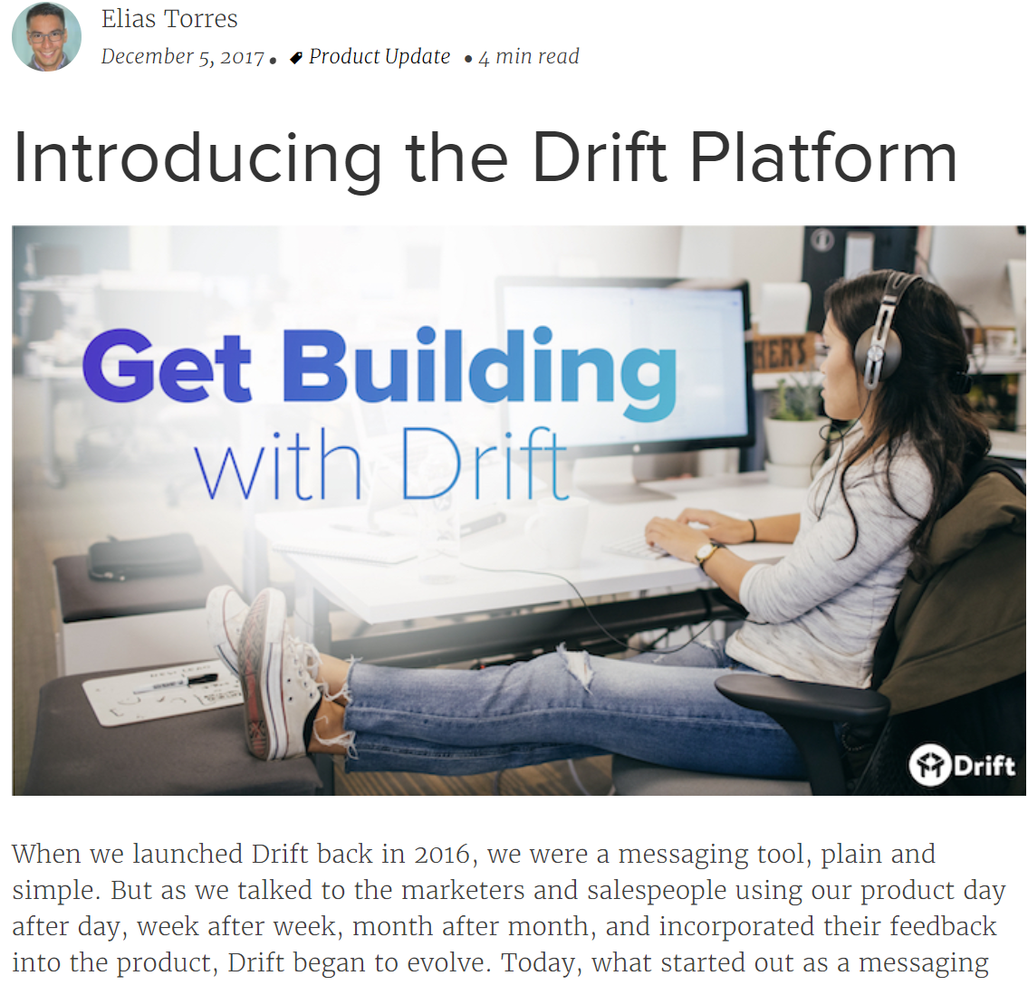
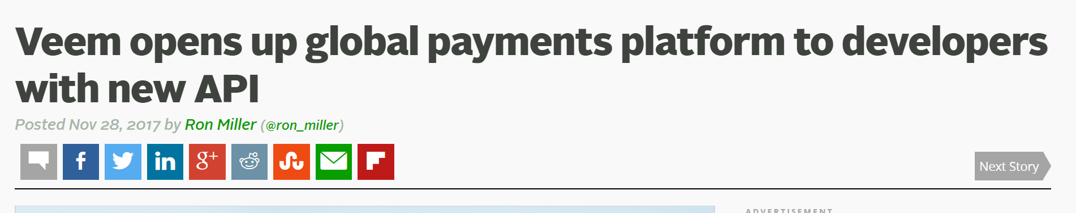
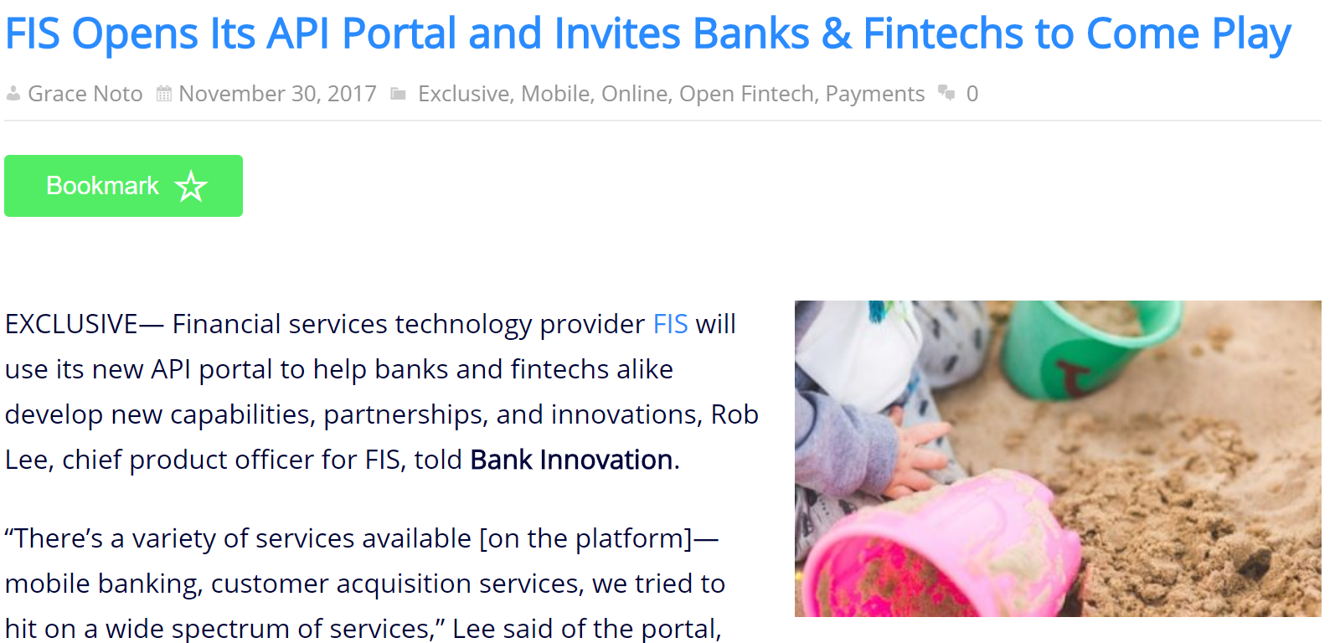
Companies Entering the Platform Ecosystem

Slide 4


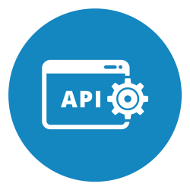

The Multi Platform Ecosystem
Average consumer
A platform is a product that can be extended by users for the benefit of others
Third party developer

Slide 5

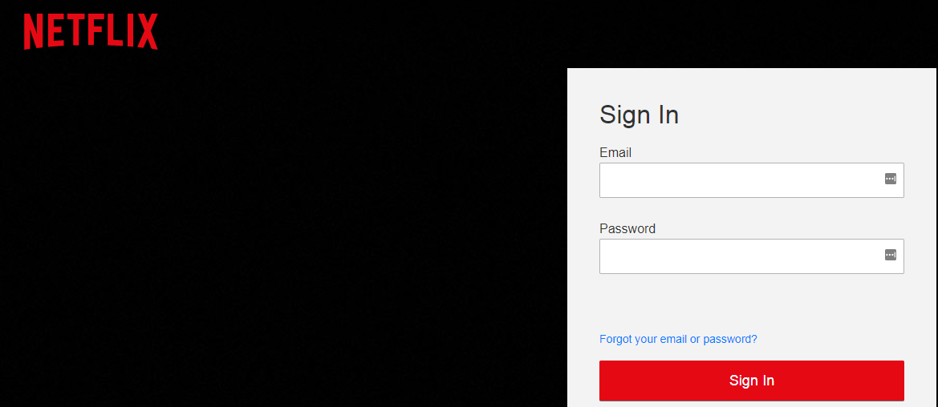


Example

Slide 6
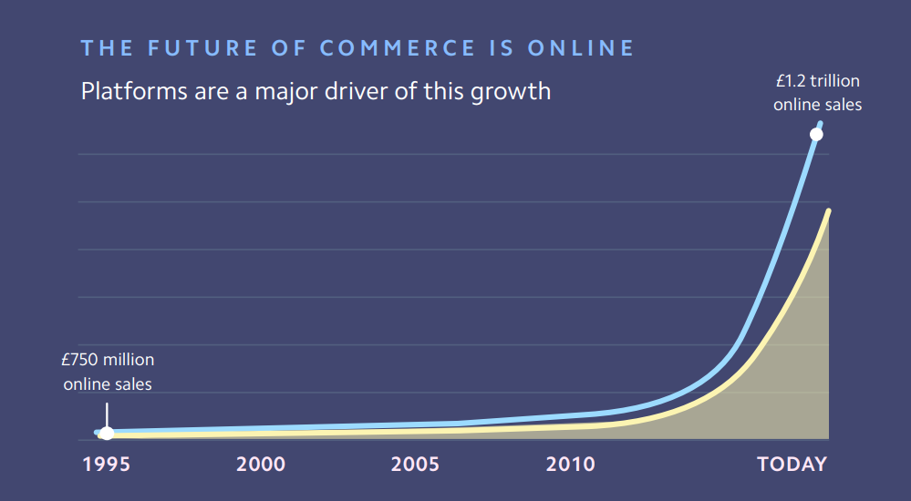
Platforms Drive The Internet’s GDP
The internet drives over 1.2 trillion Euros/ 1.5 Trillion US Dollars in sales
Platform ecosystems are a major driver of this growth

Slide 7
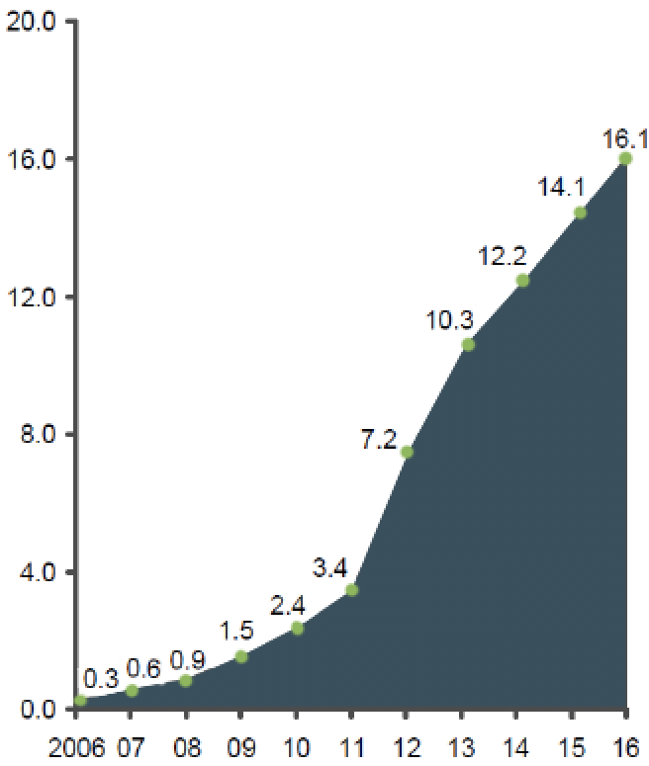
APIs By the Numbers
9 Million
Developers working on private APIs
Growth in web APIs on
ProgrammableWeb* (2005-16)**
Thousands of published web APIs
5 Billion
Daily requests to Netflix public APIs
85%
Of enterprises will have an API by 2018
90%
Of Expedia.com revenue generated through APIs
60%
Of eBay’s revenue generated through APIs
50%
Of Salesforce.com revenue generated through APIs

Slide 8



This energy creates jobs to be done…
Build more APIs, better & faster – design, document, build
Test APIs the way I test software – equip QA teams
Build faster, release continuously – embrace automation
In code, on the desktop, in the cloud, human or machine driven
Faster
Faster
Faster

Slide 9

An API First Approach
Client A
Client B
Client C
Frontend Developers
API
API
API
Mock
Mock
Mock
Implementation
Implementation
Implementation
Backend Developers
Database

Slide 10




API First Benefits
Reduced interdependencies, allows teams to work at their own pace
Faster development and delivery
Faster Development
Easier expansion to different interfaces, clients and views
New Revenue Channels and Growth
Developer friendly services to build ecosystems and platforms

Slide 11
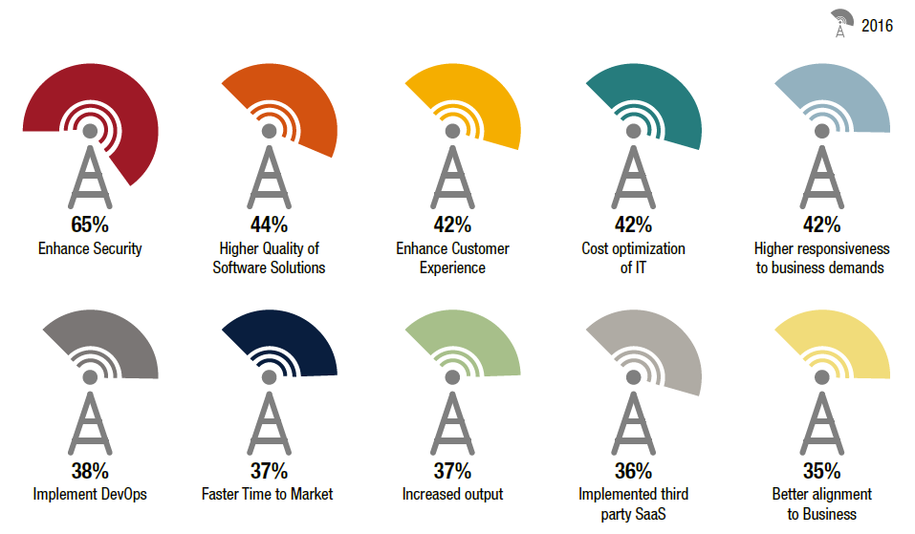
The Importance of Having Quality APIs
User experience affects your brand image – especially your public APIs
If you don’t test it, you could be exposing your customers to security risks
APIs support multiple platforms and applications, if they aren’t working properly you may be affecting a number of applications
Testing helps to find areas for innovation
Regression tests can run automatically as part of a deployment process
You can’t meet your business objectives without quality software
Management Objective with QA & Testing* World Quality Report ‘16-’17

Slide 12
API layer testing for Automation vs. UI
Understanding the service from top down
The starting point for building test frameworks
Shifting your focus and your process
What you have been doing until now
How to reuse the core of your frameworks
How to pivot and build a better strategy
Being able to reuse parts of the framework against new features,
How to refactor framework with new tests for new endpoints or changes to existing endpoints
Integrating your test framework into CI/CD pipelines is key
That way your tests can run as part of your applications build process
Learn of any misfires early
The sooner you catch a defect, the cheaper it will cost

Slide 13
Introducing SoapUI Pro

Slide 14

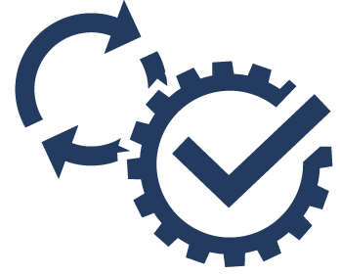
Introduction to SoapUI Pro
Functional Testing
What is it?
Validate your API behaves as expected
Add security scans to tests
Run and automate tests in a variety of scenarios
Enhance your automated tests with data
Why do I need this?
Reduce time to market, quickly build, run and repeat tests
Test early, Integrate API testing into the build process
Reduce the risk posed by malfunctioning API on the business
Why SoapUI Pro from SmartBear?
Decade-long history building API testing tools
Over 10 Million developers and testers love the intuitiveness
Powerful support for SOAP, REST and JMS testing
SOAP, REST, JMS and many more protocols
Ad hoc or data-driven
Manual or automated
Point & click for easy data transfer & validation
Record and use API interactions
Easy API definition refactoring
Notes:
Textual Slide

Slide 15


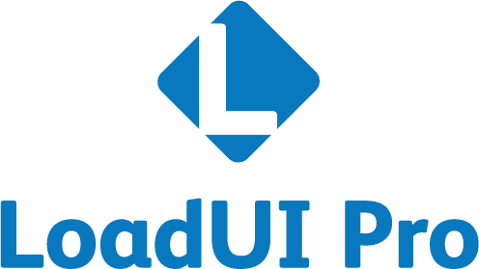



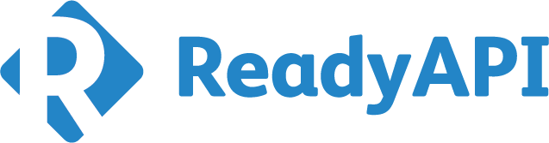
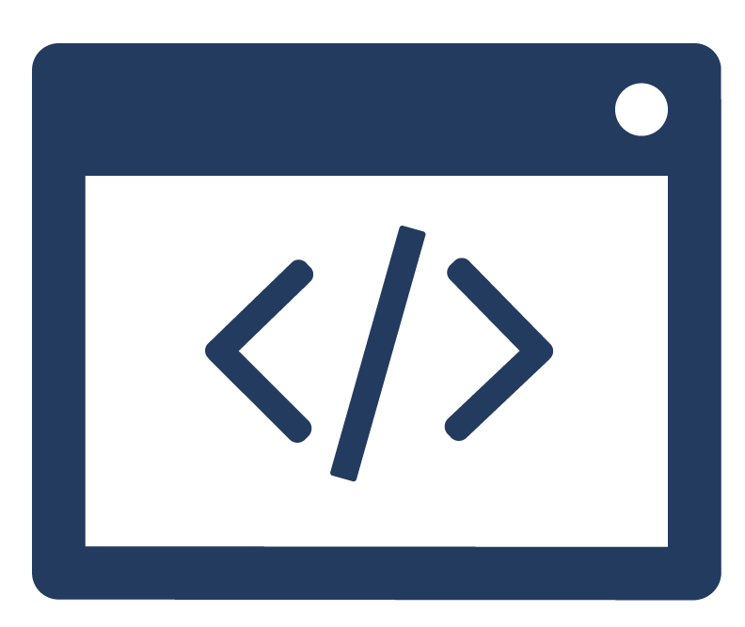

SoapUI Pro in context
Test Varied API Implementations
Test Environments
Data Driven Tests
Plugins
Quick and Easy Test Setup
Reporting
Functional Testing
Performance Testing
API Virtualization
Notes:
Ready API is a suite of API testing tools that encompasses SoapUI Pro, Load UI Pro, Service V Pro
These tools provide Functional, load and Security testing along with API virtualization capabilities.
SoapUI Pro provides complete functional testing support for your API, starting from an API definition like swagger or just an end point URL you can create rich functional test cases for your API in seconds.
You can then take your tests and run them with custom data with just a few clicks.
If you have multiple API types: like SOAP, REST and JMS in mind for testing then SoapUI pro is the perfect choice as it enables you to test all of these from the same project and user interface.
ReadyAPI provides an overarching set of capabilities to SoapUI, these capabilities include robust reporting, automation, extensibility through plugins.

Slide 16





ReadyAPI for Enterprise Success
Team
Reduces effort
Encourages Collaboration in testing
Simplifies testing by reducing complexity
Product
Increases API quality and reliability
Enhances test coverage
Increases product adoption
Management
Brings robust reporting to testing
Improves traceability of issues
Simplifies testing process
Customers
Better visibility in delivery timelines
Improves turn around time
Enables better and consistent user experience
Automation
Increase time, efficiency & API quality
Identify & address defects earlier
Reduce development & testing costs
Notes:
Textual Slide

Slide 17
Value Drivers of SoapUI Pro

Slide 18
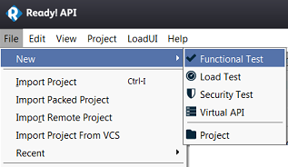
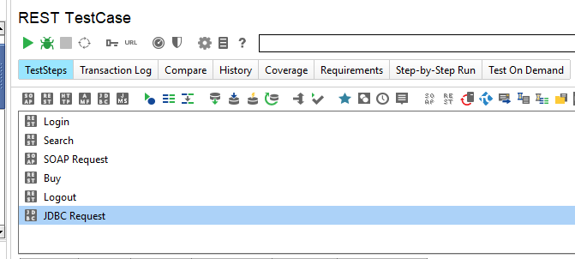
Simple and advanced functional testing
Ad-Hoc and Simple functional testing
Advanced functional testing
Quickly create and run tests from a definition (Swagger, WSDL, other definition standards), discover APIs on the fly, or URL
If the definition change, quickly refactor the tests
Add data from excel to data drive tests
Invoke multiple API types from the same test suite
Link functional test suites with large datasets and RDBMS
Debug test steps in the test suite
Notes:
SoapUI pro enables developers and testers to start testing at the most basic level and takes them all the way to the most advanced testing scenarios.
If your needs are around basic and fast functional testing, SoapUI Pro meets them, the ability to quickly see the impact of a change on your API enables faster iterations of development cycles. API tests can be created with a few clicks from definitions and URLs and API changes refactor very fast as well.
Your initial test setups can then made more valuable by customizing them, whichever way you want through scripting support. You can test any kind of API from a test suite. You can set up break points and debug the test steps. SoapUI Pro manages the complexity better. You can load data from RDBMS and make your scenarios more expansive.

Slide 19


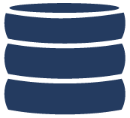

Data Driven Testing
REDUCES RISK
INCREASES QUALITY
SAVES TESTING TIME
Functional Tests
Existing functional tests in SoapUI Pro
Data Source
Upload data from Excel, csv
Import data from databases
Use packaged data in SoapUI Pro
Reliable API
Runs well on real world data
Meets SLA
Lowers error rate
Works in any environment
Notes:
Customers of SoapUI Pro are delighted with the capability of SoapUI Pro to connect with data sources, this allows users to test a multitude of scenarios in just a few clicks, earlier they had to write individual tests for scenarios just different in data and parameters.
SoapUI Pro provides many ways to incorporate data in your tests. You can include your data in a grid on the tool or import it from a csv or excel file or even connect a database to the tests.

Slide 20
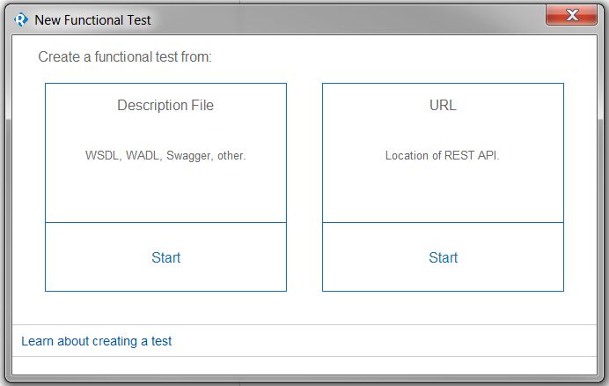
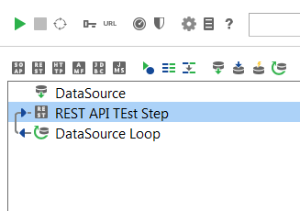
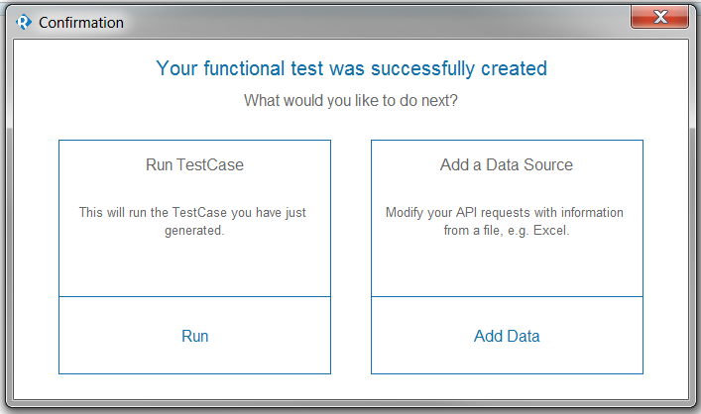
Quick and Easy Test Creation
ENGAGES THE WHOLE TEAM
REDUCES TIME AND RESOURCES FOR TEST SETUP
1
2
4
3
Notes:
SoapUI Pro allows for easy and quick test creation, with the intuitive File > New menu, a functional test can be created in just a few clicks.
Immediately after creating the test you can run it or add data source to it.
Now everyone in the team can engage with SoapUI Pro as it is so easy to use and work with. There is minimal learning and training required for getting started with SoapUI Pro and your team will get ramped up on testing in no time.

Slide 21
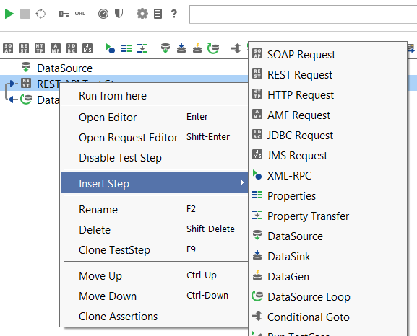
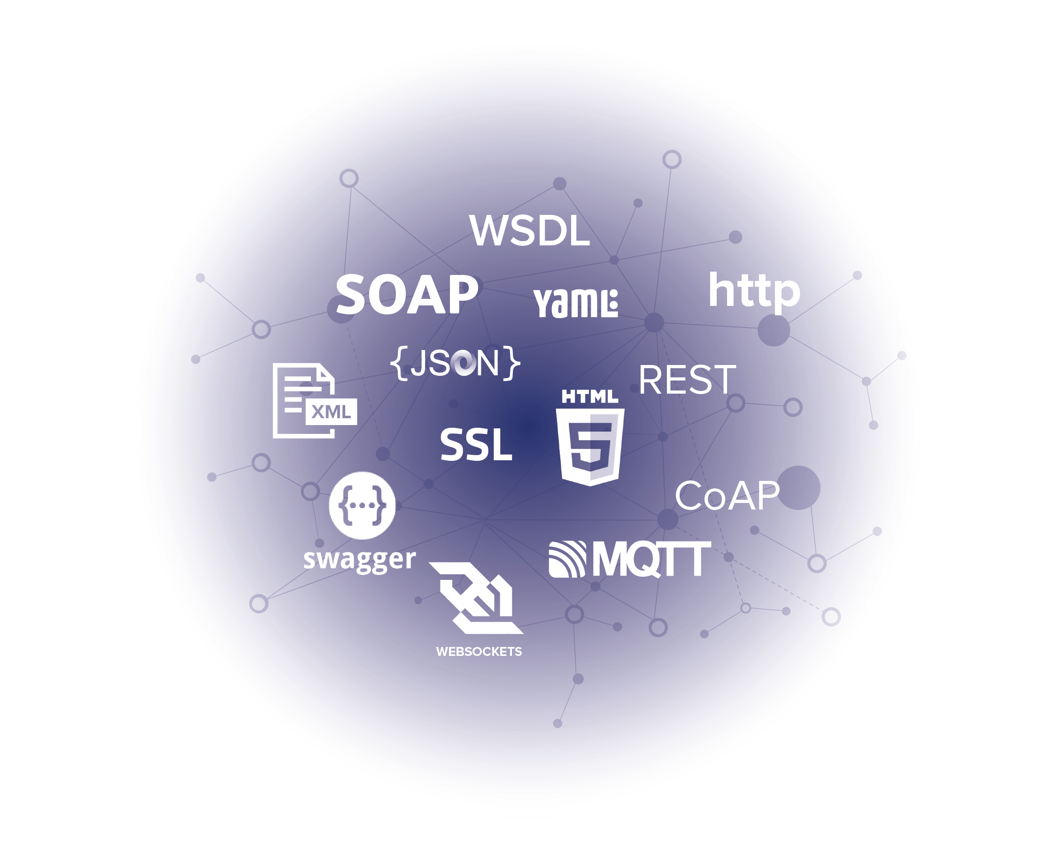
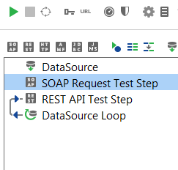
Manage test complexity better
CALLS MULTIPLE API TYPES
SIMPLIFIES API INTEGRATIONS
ORGANIZES COMPLICATED API
REST
JMS
SOAP
Multiple API types called..
Notes:
A frequent challenge with testing APIs is the possibility of expanding your API portfolio to different technologies. Often you do not just integrate with only REST based services, your frequent downstream or upstream service is a SOAP or JMS service.
SoapUI Pro allows you to manage APIs across multiple technologies through the same user interface. Thus now you don’t have to care about the technology your API is implemented in, you can integrate and test it with SoapUI Pro.
SoapUI Pro works with REST, HTTP, SOAP, JMS, XML-RPC and many others.

Slide 22
Introducing ServiceV Pro

Slide 23


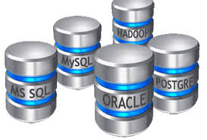

What is Virtualization?
Virtualization mimics/simulates behavior of Components that are unavailable or difficult to access while testing or development of a software.
Examples of Components:
Devices
Database
API
Network

Slide 24
Reasons why services are un-available & difficult to access
Still under development
Undergoing maintenance/ update
Difficult to set-up for testing or development
Owned by third parties
Too costly to use: Cost could be time, money
Restricted : Geographical, Security Restrictions

Slide 25
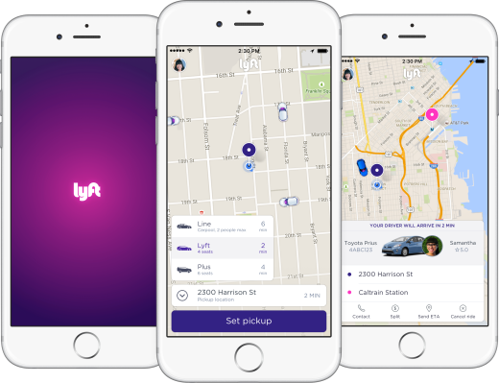



Example: Lyft app under test or development
Under Development
$ - Costly
Maps, Route API
Car Location API
$ - Costly
User Database
Payment Gateway API
Driver Database
Hard to configure: Not all data available

Slide 26

Example: Lyft app under test or development
User Database
Car Location API
Payment Gateway API
Driver Database
Maps, Route API

Slide 27

Value of Service Virtualization in Organization
Align Software development process: Resolving issues due to fragmented ownership of services across projects and products.
Remove obstacles in project completion: Provide workarounds for unavailable resources.
Enable faster software delivery: Enables development and testing teams to work in parallel.
Easier and better testing & development: Fast execution of tests, faster software development

Slide 28



Value Drivers of ServiceV Pro
Seamless integration with functional API testing
Quickly create and use Virtual environment for services like APIs and Databases
Easily record services, modify them and use them for testing and development
Make virtual services realistic by linking them to data
Easily route between virtual and actual service
Provide access to the team by sharing the virtualized transactions
Cost Savings
Faster Time to Market
Full Control

Slide 29
Introducing SecurePro

Slide 30
Introduction to Secure Pro
What is it?
Secure Pro is a powerful approach to API security, combining data driven testing with automated scanning capabilities to empower teams of testers to seamlessly check the safety of their APIs as part of their existing continuous delivery process.
Benefits of using Secure Pro:
Test the security of both REST and SOAP services
Catch server-side configuration errors resulting from invalid data
Check for sensitive file exposure on servers
Validate that tests do not contain weak authentication
Notes:
Textual Slide

Slide 31











































Success with SmartBear
>50% of sales via digital channels (incl. mobile)
>25% of sales via mobile
>50% savings by switching from HP Testing solutions
Started meeting release dates
Drastic API quality improvement
Reduced costs by $500,000 annually
Significant reduction of homegrown tools
62% automation coverage of regression cases via Jenkins driven CI platform
HEALTH SCIENCES
FINANCIAL
SERVICES
TRAVEL / HOSPITALITY
CONSUMER
TELECOM
GOVERNMENT
/ DEFENSE
SOFTWARE
TECH

